Slide 1
Software Engineering and Architecture
Mandatory Reflections

Slide 2
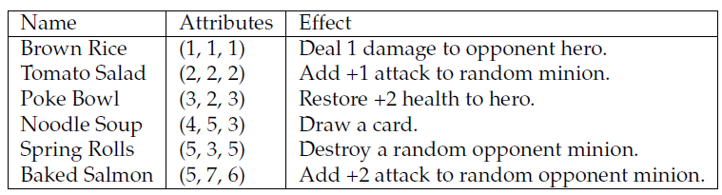
EtaStone = Card Effects
Card Effects = The fun begins
This is the core game mechanics of HearthStone
What is it?
Given a trigger, modify the game’s state (trigger = play card)
This resembles something we have seen before?

Slide 3
Effects
Seen before, yes
Given a trigger, modify the game’s state (trigger = use power)
It is a role that a game object can play ☺
Role Interface: Effectable (‘able to trigger an effect’)

Slide 4

Effectable
So
Which signals that cards and heroes have the following responsibilities

Slide 5
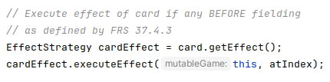

Thus triggering an Card Effect
As Game knowns that a card has the responsibility to provide its effect, it can simply (during playCard()) do
“Card, hand me your effect, and then I will execute it.”
In usePower() method, same thing goes on
Do the same thing, the same way...

Slide 6

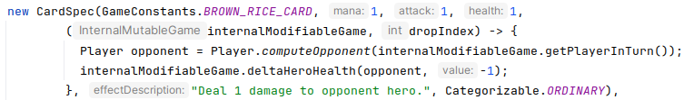
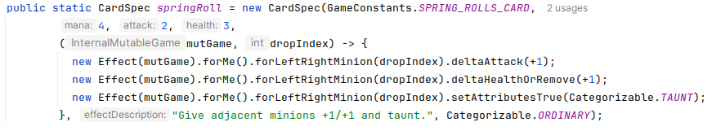
Effects as Lambdas
My EffectStrategy only has a single method...
... So I can code them as lambda functions
From my PiStone, using WizardHub

Slide 7
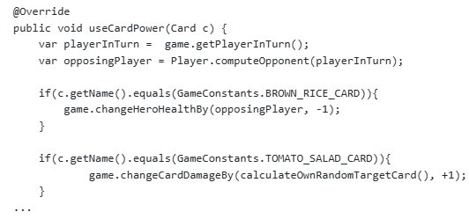
Some opt for “flatter design”
The effect strategy is associated with Game, not Card
A good design: open for extension, closed for modification
It has the ‘card type switch’ in the strategy, not in game
Liability
The switch can become pretty long
(HearthStone = > 1000 cards)

Slide 8
From last week’s cancelled lecture...
One major issue that needs to be stated...

Slide 9
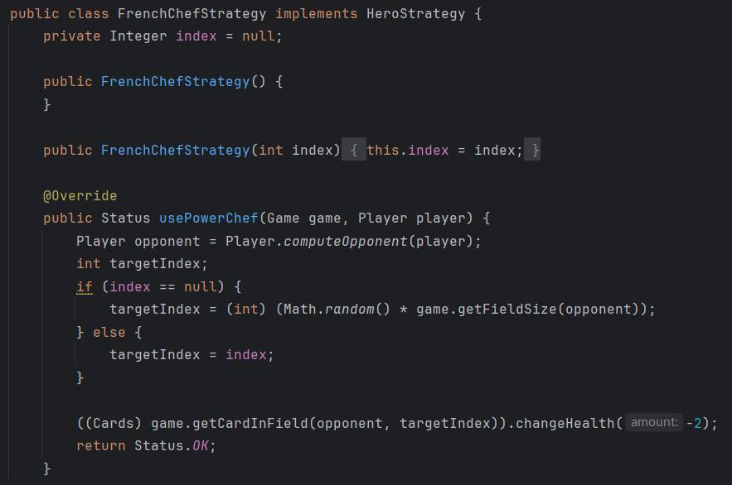
No Doubles in Production
What is the issue with this “test stub”?
(Which per definition is not a test stub…)
Notes:
Answer: The test double / stub behaviour is not a replacement, but a parametrisk solution in the production code and runs the risk that someone will turn it on in production

Slide 10
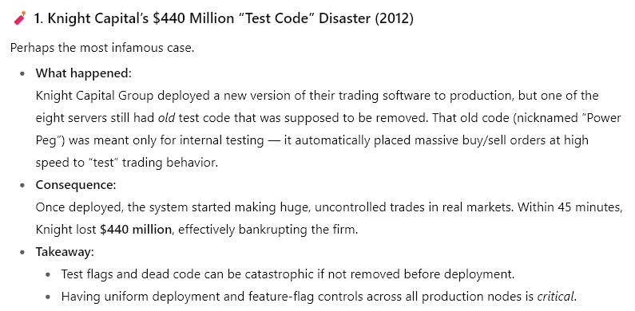
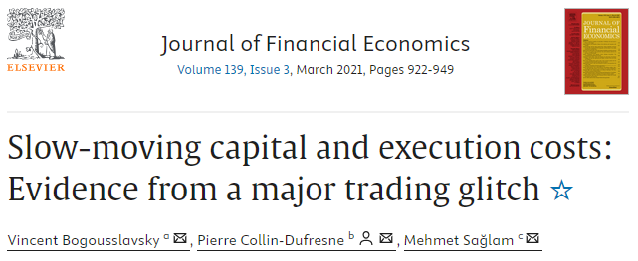
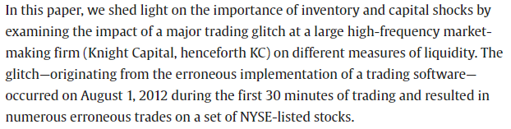
Test Code in Production
One such example
Thanks to ChatGPT

Slide 11
From Earlier Years

Slide 12
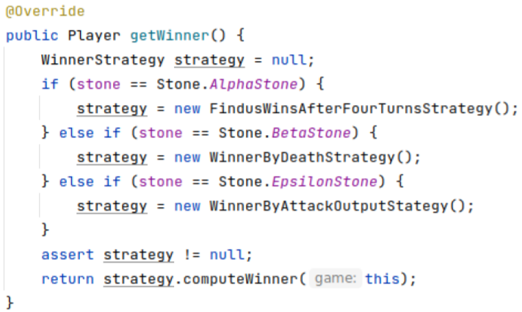
From the Trenches
What is problematic here?
Assuming this method is in Game?
Notes:
It is actually a fine state pattern, but if it is located inside Game, then Game can only support 3 variants of HotStone – it is change by modification

Slide 13
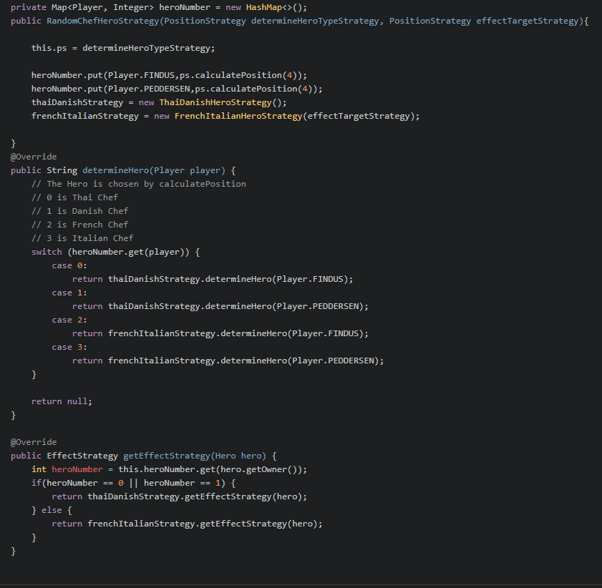
Overengineering
What is happening?
SemiStone’s “pick random hero”
???

Slide 14
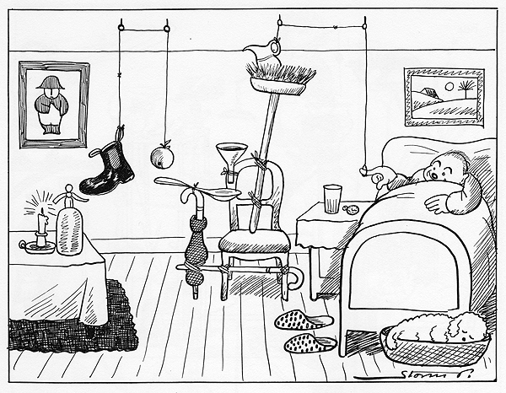
Overengineering
What is happening?
SemiStone’s “pick random hero”
Overengineer
Overly complex solution to simple problem
Storm P
Avoid his creations

Slide 15

Factory (?)
A factory for SemiStone
Or – is it???
Find two aspects that are problematic here
Notes:
A) A factory creates objects, it is not told which objects to hand out (then you need a factory to create the factory!) B) It is storing two strategies and I guess then that these are returned in the createX() methods – but then the factory does not create objects which is the responsibility of a factory; not storing them. You do not get new objects every time!

Slide 16
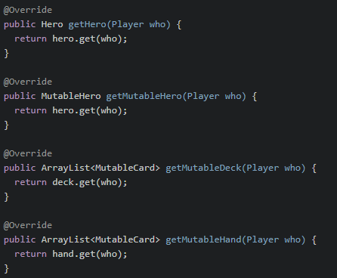
Cast to Interface
Cast to an interface is not problematic; cast to class is.
MutableHero h = (MutableHero) getHero(who);
One example of avoiding it
Benefits?
Liabilities?
Notes:
We get kind of code duplication, but I actually find this solution OK

Slide 17
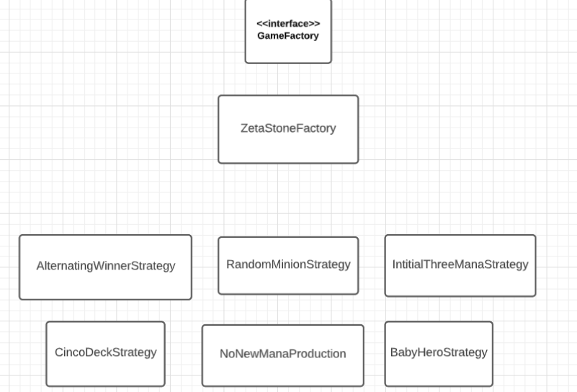
Simple, but too Simple
A UML with 1000 lines is worthless, but do not fall in the other pitfall ☺

